Slide 1
Data structure and programming logic
Introductory Data Science for Innovation (995N1)
Week 2
David Eggleton
Notes:
This is a bit tight lecture – leave more time for exercises
For the exercises leave more time around 15 minutes for each
Explain better what the exercise is trying to achieve in class
After people had a chance to look at the summary come back in class and check what should be transformed.
Explain what the pipe symbol will be – how it works
Maybe remove the exercises about what could be improved in the different tables

Slide 2
Group presentations
Don’t forget to add your groups in the google doc by next week (Week 3).
See assessment information page

Slide 3
Today’s Agenda and LOs
Looking at the absolute fundamentals of data science
Manipulating data types and structures to make data science cleaner
Playtime!
Know about ‘primitives’, data types and structures
Have a basic understanding ‘tidyr’ and ‘dplyr’
Know how this works in practice

Slide 4
Session objectives
Basics of data science:
This session will present you with the foundational toolbox to get started with Data Science.
This session introduces many concepts; it is aimed to be a resource that you can build on for any of your future project.
I encourage you to open R or Rstudio to reproduce the code.

Slide 5
Practical objectives
Bases of data science:
Data types and structure
Is there a better data structure to analyse data?
General programming logic
What are the general operators to give commands to a computer?

Slide 6
Data types and structure

Slide 7
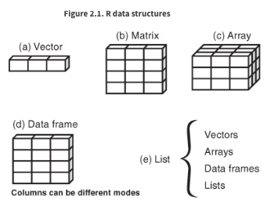
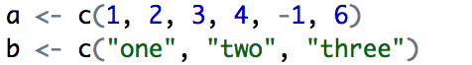
Data semantics
Most common R data structures that you may encounter are:
All the data have to be the same type of data

Slide 8
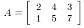
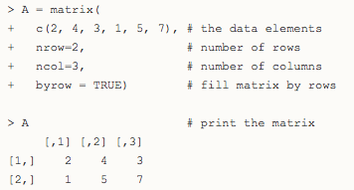
Data semantics
Most common R data structures that you may encounter are:
All the data have to be the same type of data
http://www.r-tutor.com/r-introduction/matrix

Slide 9
Data semantics
Most common R data structures that you may encounter are:
Data within columns have to be of the same type
Columns can be of different types.

Slide 10
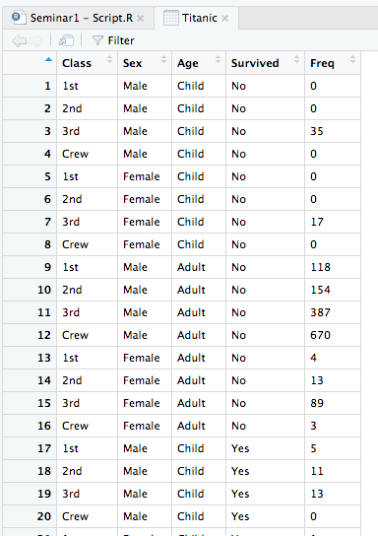
Data semantics
Most common R data structures that you may encounter
Data from seminar 1: Titanic and Iris

Slide 11
What are the main data types that we will encounter?

Slide 12
Data types
What types of variables are present?

Slide 13
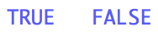
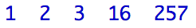
What are the main types of data?
Most common R data structures that you may encounter are:
Logical 🡪 only two possible values
Numeric 🡪 this is any type of number (two main types integer: whole numbers, double: decimal number)
Character 🡪 text data, defined in “quotation marks”. (aka Chars)
Missing data have also a representation:
NA (not available) 🡪 is there where there may be missing values
NaN (not a number) 🡪 impossible number like when divided by 0

Slide 14
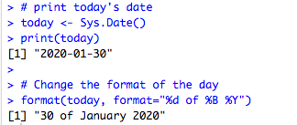
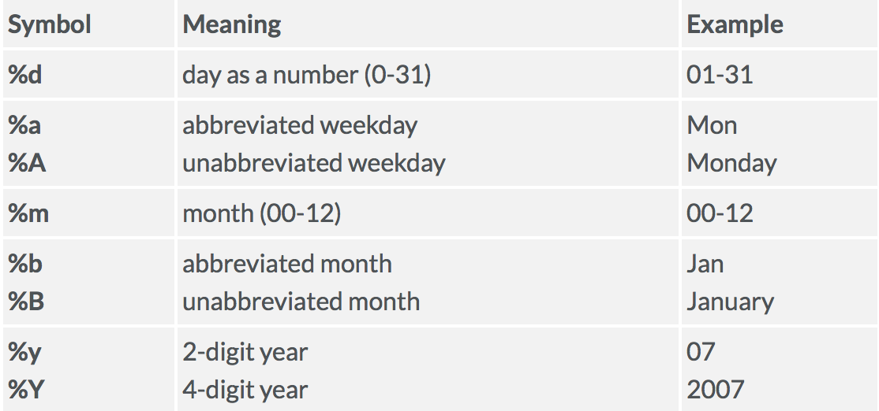
What are the main types of data?
Most common R data structures that you may encounter:
Factor 🡪 Looks like textual data,
but we want the data to be grouped by value.
Date 🡪 Looks like numeric data, but we want the data to be recognised as date format. Dates can be a real pain to deal with
R default format for dates is yyyy-mm-dd
Recognised as the same value

Slide 15
Data types
What types could we alter?

Slide 16
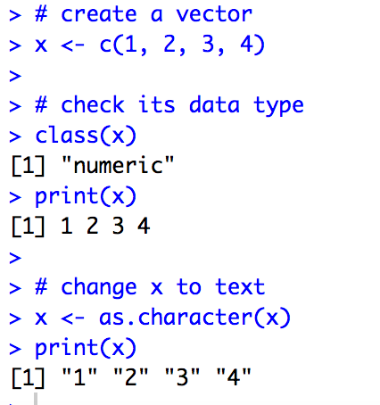
Data semantics
Converting types:
It may be desirable to transform one type of data into another:
🡪 to be able to order them
🡪 to allow certain types of operation
Use operator to change the type of variable:
as.numeric(x), as.character(x), factor(x)…
Notes:
Teams have different skills

Slide 17
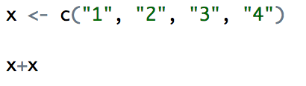
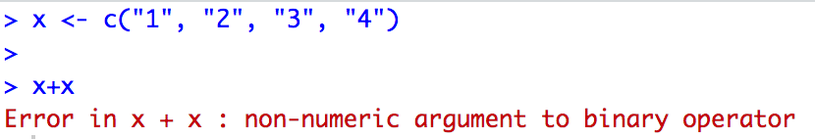
Data semantics
What would the result of this be?
Notes:
Teams have different skills

Slide 18
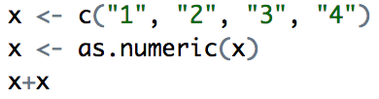
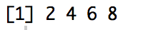
Data semantics
What would the result of this be?
Notes:
Teams have different skills

Slide 19
Data types
It is important to understand the type of the data:
To know the kind of operation that can be done with them
Avoid generating errors or NaNs when transforming data
Check the data type with class() to see whether some operations are possible.
If the data is the wrong type, tell R how you want your data to be considered.
Notes:
Teams have different skills

Slide 20
Datasets (i.e. data frames)
Is there a best way to organise them?

Slide 21
What makes a dataset tidy? Wickham (2014), “Tidy data”

Slide 22
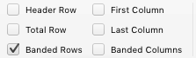
Data structure
Datasets in most cases are represented in rectangular tables,
With a number of n rows and m columns

Slide 23
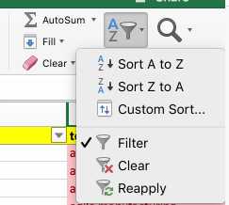
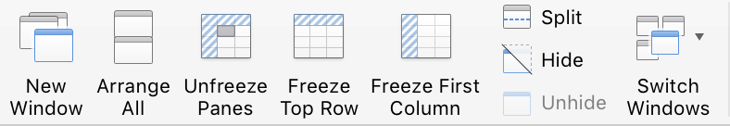
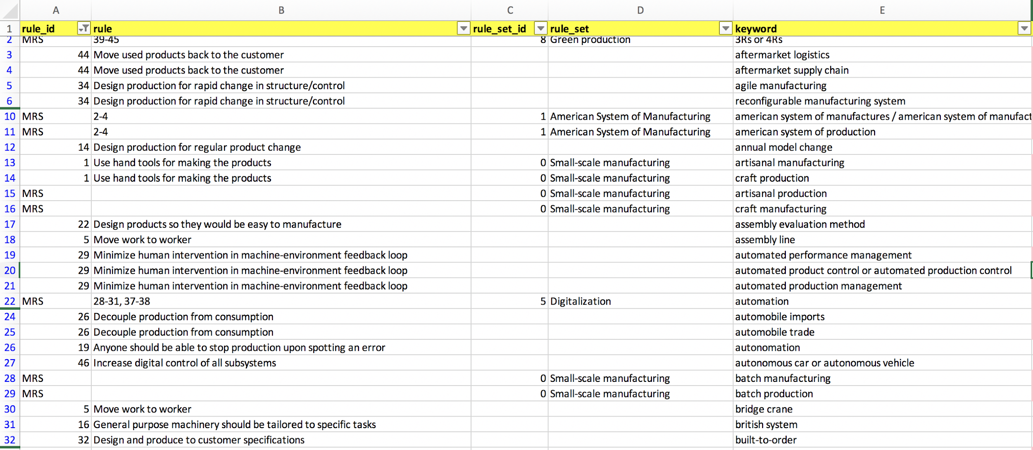
Data structure
How does it look like in Excel?

Slide 24
Data structure
Datasets represents:
a set of values
from a specific observation
looking at certain characteristics (i.e. variables)

Slide 25
Data structure
Datasets represents:
a set of values
from a specific observation
looking at certain characteristics (i.e. variables)
Tidy data:
Each observation 🡪 represented in a single row
Each variable 🡪 represented in a column
Values of each variable for each observation is contained in the remainder of the table
🡪 These are data frames (see above)
Notes:
Teams have different skills

Slide 26
Data structure

Slide 27
Data structure
Observations

Slide 28
Data structure
Variables :
Dimensions of interest

Slide 29
Data structure
Values

Slide 30
Data structure
There are no (Freq)
first class (Class)
male (Sex)
child (Age)
who has died (Survived).

Slide 31
Data structure
There are four possible value of Class:
1st
2nd
3rd
Crew

Slide 32
Datasets can be untidy in many different ways… Wickham (2014), “Tidy data”

Slide 33
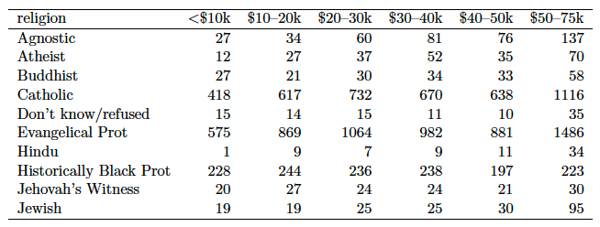
Data structure
(1) Column headers are values, not variables
Source: Wickham (2014), “Tidy data”, Journal of Statistical Software, 59(10)
Notes:
Teams have different skills

Slide 34
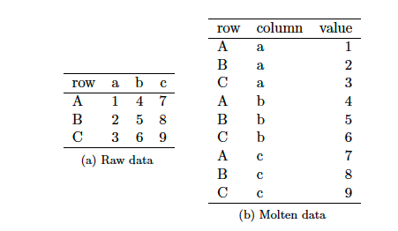
Data structure
(1) Column headers are values, not variables (tidy)
Source: Wickham (2014), “Tidy data”, Journal of Statistical Software, 59(10)
Notes:
Teams have different skills

Slide 35
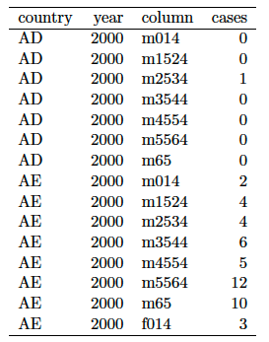
Data structure
(2) Multiple variables are stored in one column
Source: Wickham (2014), “Tidy data”, Journal of Statistical Software, 59(10)
Notes:
Teams have different skills

Slide 36
Data structure
(2) Multiple variables are stored in one column
Sex and Age are included in this column.
Source: Wickham (2014), “Tidy data”, Journal of Statistical Software, 59(10)
Notes:
Teams have different skills

Slide 37
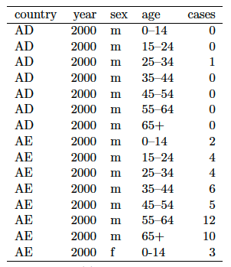
Data structure
(2) Multiple variables are stored in one column (tidy)
Source: Wickham (2014), “Tidy data”, Journal of Statistical Software, 59(10)
Notes:
Teams have different skills

Slide 38
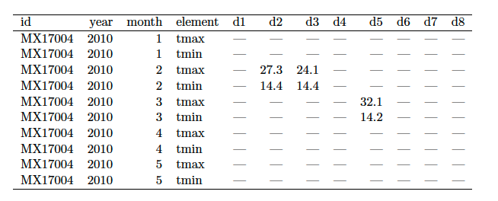
Data structure
(3) Variables are stored in both rows and columns
Source: Wickham (2014), “Tidy data”, Journal of Statistical Software, 59(10)
Notes:
Teams have different skills

Slide 39
Data structure
(3) Variables are stored in both rows and columns
These could be considered as values.
Source: Wickham (2014), “Tidy data”, Journal of Statistical Software, 59(10)
Notes:
Teams have different skills

Slide 40
Data structure
(3) Variables are stored in both rows and columns
These could be considered as variable.
Source: Wickham (2014), “Tidy data”, Journal of Statistical Software, 59(10)
Notes:
Teams have different skills

Slide 41
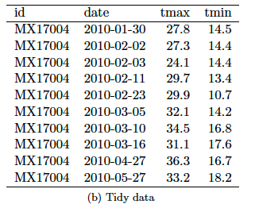
Data structure
(3) Variables are stored in both rows and columns (tidy)
Source: Wickham (2014), “Tidy data”, Journal of Statistical Software, 59(10)
Notes:
Teams have different skills

Slide 42
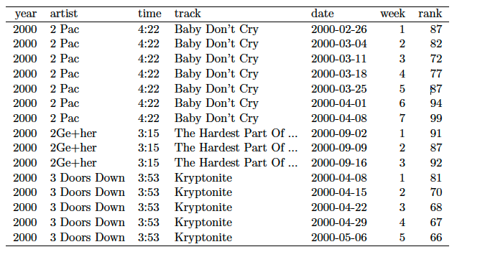
Data structure
(4) Multiple types in one table
Source: Wickham (2014), “Tidy data”, Journal of Statistical Software, 59(10)
Notes:
Teams have different skills

Slide 43
Data structure
Multiple types in one table
Table 2
Table 1
Source: Wickham (2014), “Tidy data”, Journal of Statistical Software, 59(10)
Notes:
Teams have different skills

Slide 44
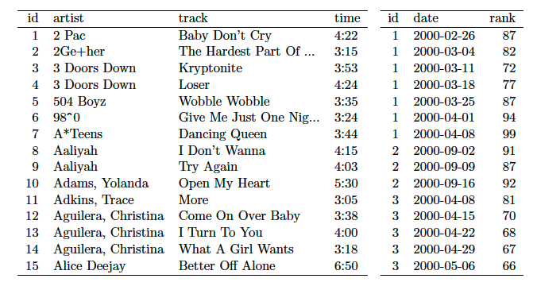
Data structure
Multiple types in one table (tidy)
Source: Wickham (2014), “Tidy data”, Journal of Statistical Software, 59(10)
Notes:
Teams have different skills

Slide 45
Data structure
To sum up the most frequent problems with untidy datasets:
Column headers are values, not variables
Multiple variables are stored in one column
Variables are stored in both rows and columns
Multiple types of observational units are stored in the same table
A single observational unit is stored in multiple tables
Notes:
Teams have different skills

Slide 46


Tools to make a database tidy:

Slide 47
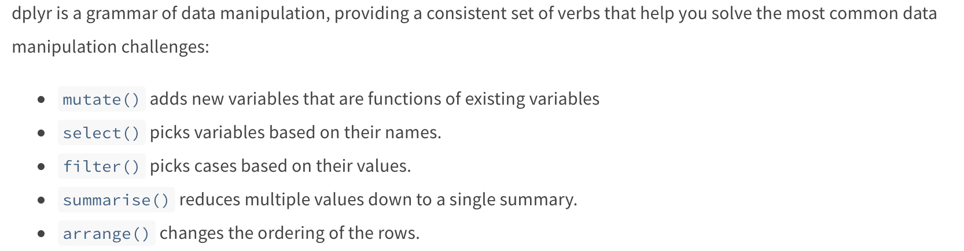
Dplyr: functions for tidying

Slide 48
Dplyr: functions for tidying
These functions enable to prepare datasets for analysis looking at variables
Making operation on columns:
🡪 Only keep columns needed for the analysis (select)
🡪 Make new variables (columns) from previous variables (Mutate)
🡪 Arrange columns in a specific way (select – again)
🡪 Change variable name to be more understandable (rename).
Cheatsheet: https://raw.githubusercontent.com/rstudio/cheatsheets/main/data-transformation.pdf

Slide 49

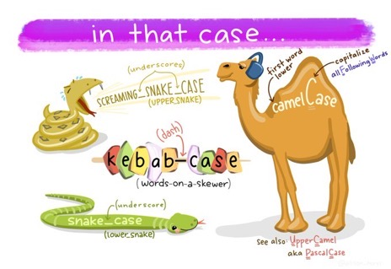
TIP
Name columns and variables
Variable names is very important to make code understandable for others but for you future self!
(coding standard)
Use descriptive name (descriptive strings)
You can use multiple words using camelCase, snake_case, kebab-case, PascalCase
In naming variables you cannot use spaces between words.
It varies from programmer to programmer and even language to language and type to type: https://en.wikipedia.org/wiki/Naming_convention_(programming) for more information
Artwork by @allison_horst

Slide 50
Dplyr: functions for tidying
These functions enable to clean datasets for analysis making operation on entries
Making operation on rows:
🡪 Only keep entries of interest (filter)
two main uses: dealing entries with incomplete or erroneous data
analyse a subset of the data wit specific
characteristics (e.g. variables)
🡪 Arrange columns in a specific way (arrange)

Slide 51
Dplyr: functions for tidying
These functions enable to prepare datasets for analysis looking at variables
Simplifying the dataset:
🡪 Summarise: enables to reduce the size of the existing data frame, with summary statistics.
🡪 With group_by(), we can generate such summary for observations sharing the same characteristics.

Slide 52
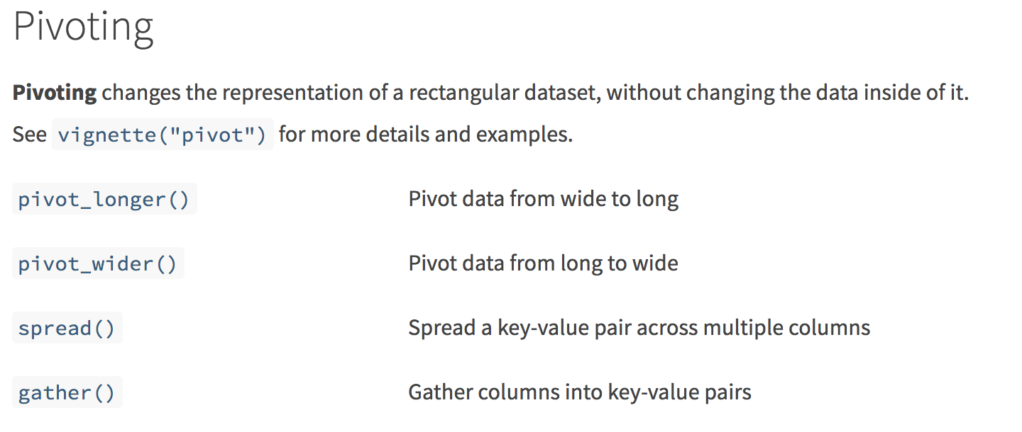
TidyR: functions for tidying
In September 2019 the package tidyr has been updated, the functions for gather and spread have been updated.

Slide 53
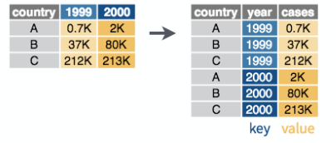
TidyR: functions for tidying
For pivot longer 🡪 pb of column headers are values
Country %>%
pivot_longer( -country, names_to=“year”, values_to=“cases”)

Slide 54
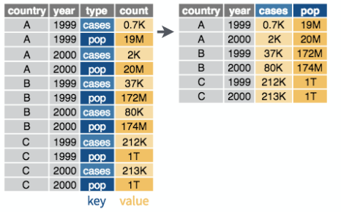
TidyR: functions for tidying
For pivot wider 🡪 pb of values being variables
Country %>%
pivot_wider(names_from=“type”, values_from=“count”)

Slide 55
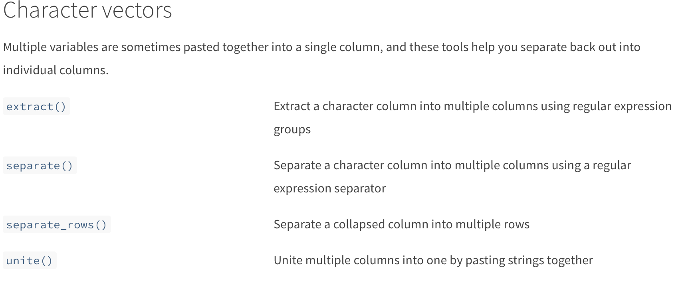
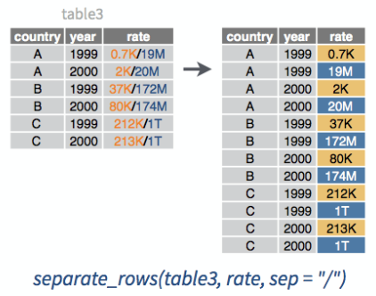
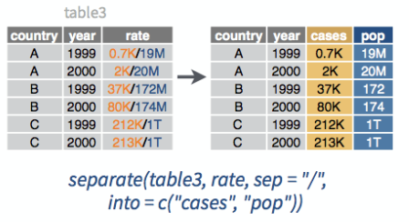
TidyR: functions for tidying
Transform columns
🡪 Pb of multiple variables are stored in one column
separate()
separate_rows()

Slide 56
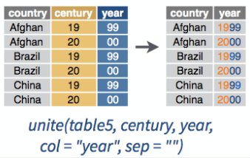
TidyR: functions for tidying
Transform columns
🡪 Merge variable onto one (example dates)
unite()

Slide 57
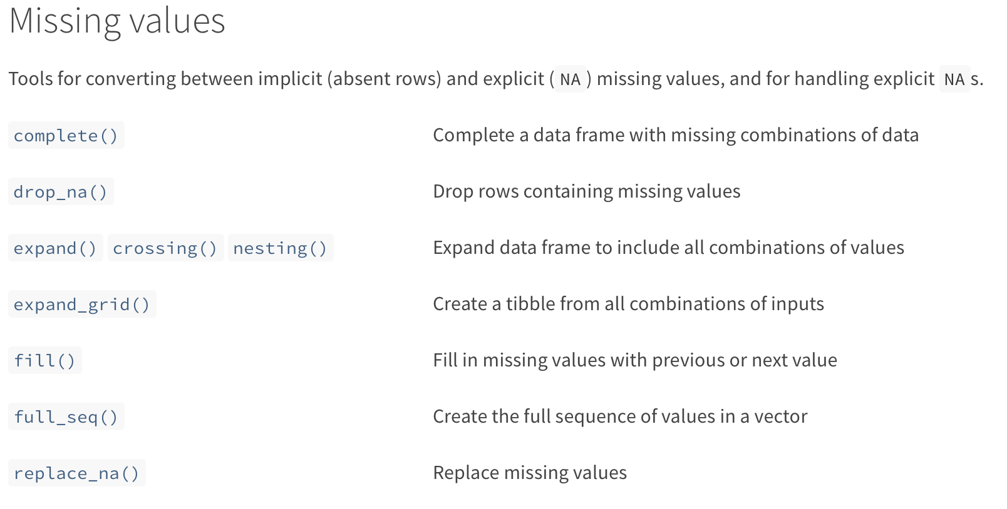
TidyR: functions for tidying
Deal with empty or missing values:

Slide 58
Programming 1.0.1

Slide 59
Programming 1.0.1
Logic and automation:
In order to automate a series of action with a computer, one needs to communicate using a set of symbols, specifying rules.
There are a set of tools to give those instructions:
Refer to a specific subset of your data (Boolean logic)
Apply an action to these subsets (conditions)
The ability to repeat the statements to apply to all observations (iterations)

Slide 60
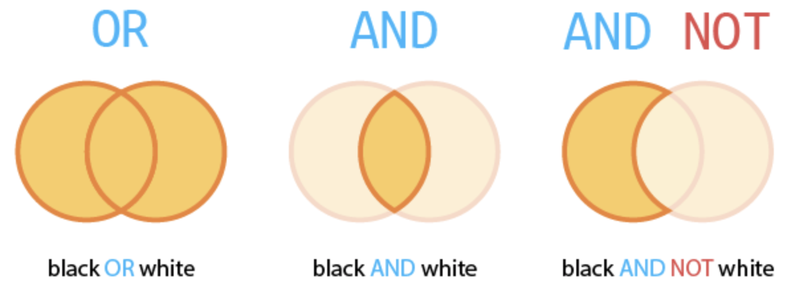
Boolean logic
Referring to a specific subset of the data:

Slide 61
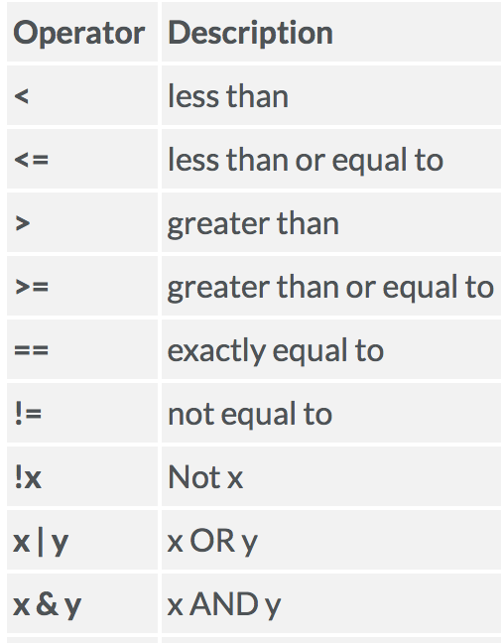
Boolean logic
Logical operators in R:

Slide 62
Boolean logic
Logical operators in R:
Operators for numeric variables
General operators

Slide 63
Conditions
Boolean logic enables and conditions:
Making rules for observation of different sets
Filter the set you want to work with (Research Questions)
Working with outliers or missing values
Apply corrections for observation does not conform to a variable specification (e.g. negative age)

Slide 64
Conditions
For applying a specific action for a targeted subset we use conditions:
The general syntax is as follows
If an object is:
Then: it is grey

Slide 65
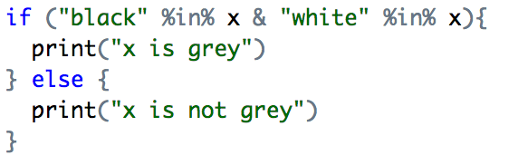
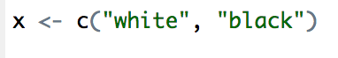
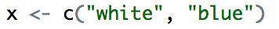
Conditions
Syntax in R:

Slide 66
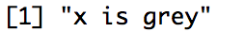
Conditions
Syntax in R:
Other possible syntax:

Slide 67
Iterators
Conditions and iterators:
Iterator 🡪 repeating an action a certain number of times
You may want to adapt the action you are taking depending on the characteristic of the variable.

Slide 68
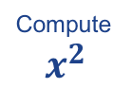
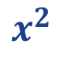
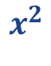
Iterators
For some cases, one wishes to repeat a certain action a number of times,
or until a certain condition is met.
For example: for the number 1 to 10, I would like to know the square of these number.
Take a number
x of value which will take the value 1 to 10
x : 1
x : 2
x : 10
stop
…
1
4
100

Slide 69
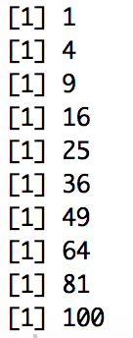
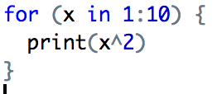
Iterators
For some cases, one wishes to repeat a certain action a number of times,
or until a certain condition is met.
For example: for the number 1 to 10, I would like to know the square of these number.

Slide 70
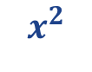
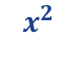
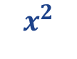
Iterators
For some cases, one wishes to repeat a certain action a number of times,
or until a certain condition is met.
For example: I would like to know the square of these number, while the number is inferior to 5.
x <- 1
x = 4
Take a number
x assign it to a number
do something with x
Check if the condition is still true…
is x < 5?
is x < 5?
is x < 5?
is x < 5?
…
False
🡪 STOP
1
4
16
x <- 2
x <- 3
x <- 5
Notes:
4

Slide 71


Iterators
For some cases, one wishes to repeat a certain action a number of times,
or until a certain condition is met.
For example: I would like to know the square of these number, while the number is inferior to 5.

Slide 72
Iterators
For some cases, one wishes to repeat a certain action a number of times,
or until a certain condition is met.
For example: I would like to know the square of these number, while the number is less than 5.
Don’t forget to iterate,
If not the code will get stuck!

Slide 73
Let’s Practice!

Slide 74
Let’s start!
Load the Script of this week:
Understand the dataset
REPLACE _ _ by the appropriate value/function in the code
The exercise / questions are available in the comments (e.g. after the # in the Rscript)
#-----------------------------------------
# 1. Explore the given dataset
#-----------------------------------------

Slide 75
Let’s code!
Continue with the second step:
Reshape the dataset
REPLACE _ _ by the appropriate value/function in the code
The exercise / questions are available in the comments (e.g. after the # in the Rscript)
#-----------------------------------------
# 2. Reshape the given dataset
#-----------------------------------------

Slide 76
Let’s code!
Continue with the third step:
Remove the missing values
REPLACE _ _ by the appropriate value/function in the code
The exercise / questions are available in the comments (e.g. after the # in the Rscript)
#---------------------------------------------
# 3. Using logic in you code
#---------------------------------------------

Slide 77
Have a go at finishing 4. 5. for next week.
(David’s note - it’s actually quite challenging. Use the cheatsheets and ‘stackoverflow’ to find the solutions when you have issues especially at the more advanced stuff)

Slide 78
Today’s Agenda and LOs
Looking at the absolute fundamentals of data science
Manipulating data types and structures to make data science cleaner
Playtime!
Know about ‘primitives’, data types and structures
Have a basic understanding ‘tidyr’ and ‘dplyr’
Know how this works in practice

Slide 79
Thank you. Contact:
David Eggleton
(d.eggleton@sussex.ac.uk)

